Slide 1

Healthcare Management Organization
Team 2:
Aditi Pala
Indra Ariunbold
Rujuta Mirajkar
Jaineel Parmar
Rithvik Segu

Slide 2
Agenda
Introduction
Overview
Data Reading
Models
Recommendations & Limitation
Conclusion

Slide 3
Healthcare Management Organization
Based on the given data, the case's main objective is to offer actionable insight and precisely estimate which person’s healthcare cost will be expensive.
The dataset includes statistics on healthcare expenses from an HMO (Health Management Organization). In the dataset each row represents a person.
Our team's objective is to comprehend the primary reasons, why some individuals spend more on health care(i.e., require more medical attention) and to forecast which individuals will be expensive (in terms of medical expenses).

Slide 4
Model Flow of the Project
UNDERSTANDING KEY DRIVERS IN DECIDING HEALTHCARE EXPENSIVENESS
Analyzing Data
to determine which factors to choose
Running the models -
1. SVM
2. KNN
3. Logistic
4. Neural Network

Slide 5
Problem Statement
To predict who will spend a lot of money on health care in future.
Segregating health care costs as expensive or not expensive based on location and location type.
Provide actionable insight to the HMO, in terms of how to lower their total health care costs, by providing a specific recommendation on how to lower health care costs.

Slide 6
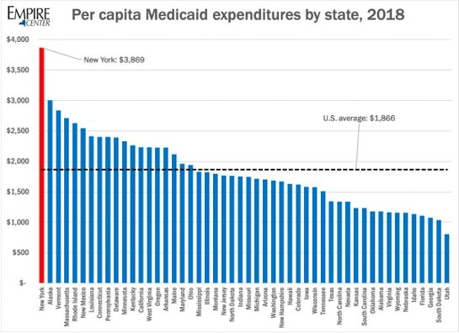
-Different states in the US have different average healthcare costs
-Earnings of each individual has not been provided.
Hence it is important to have threshold by each state rather than having one threshold for the entire dataset

Slide 7
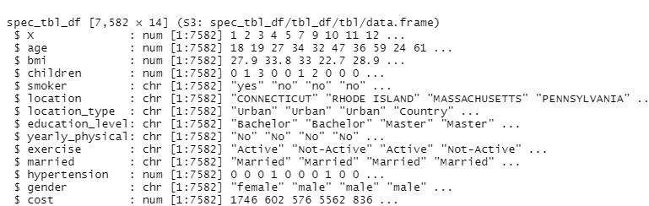
Technical Details
Cost, Location, Location Type are few of the most important variables.

Slide 8
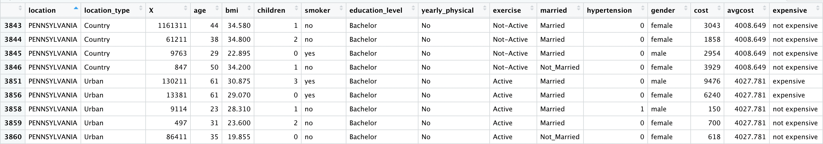
Deciding Factor in Expense Report
Dataset after deciding whether person's healthcare costs are expensive or not expensive

Slide 9
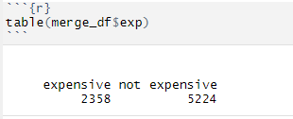
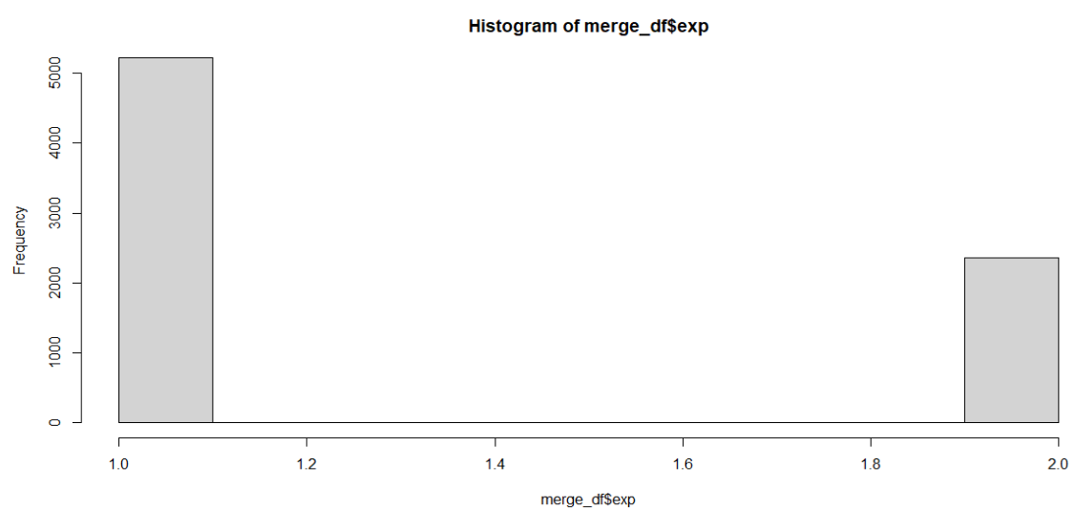
Expensive vs Non-Expensive Graph
Based on dataset of 7582 attributes 2358 are expensive and 5224 are not expensive.

Slide 10
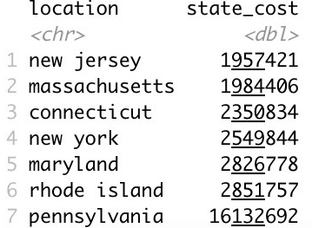
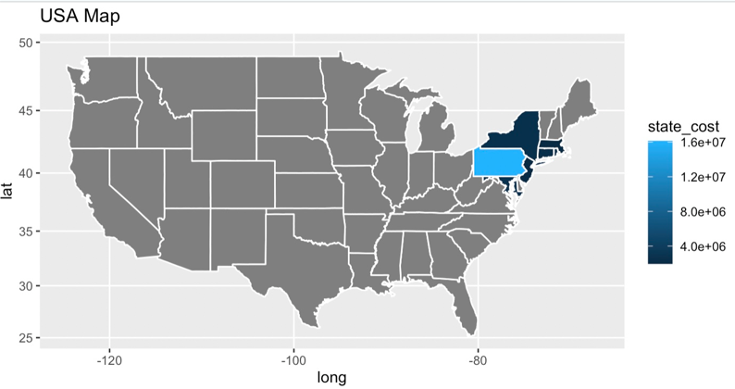
Geographical Represenation of Expenses
Pennsylvania has the highest cost expenses with 16132692.
The least cost expense is for New Jersey state with 1957421.

Slide 11
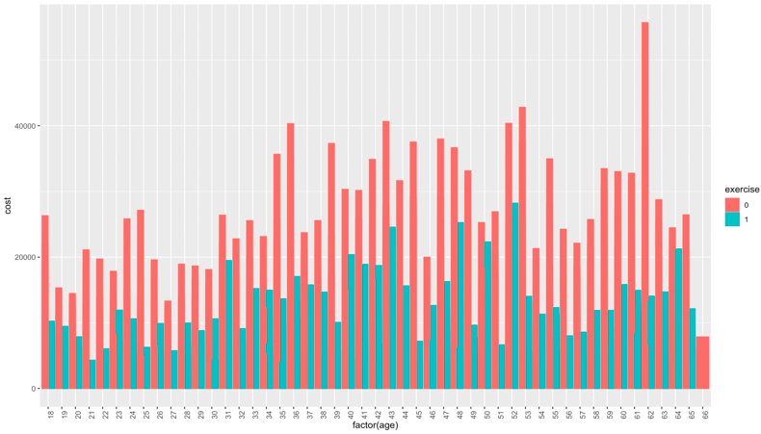
Expensive healthcare costs
Here we can see trend analysis of age vs cost of healthcare for individuals who are not exercising regularly that are paying greater than average healthcare cost.

Slide 12
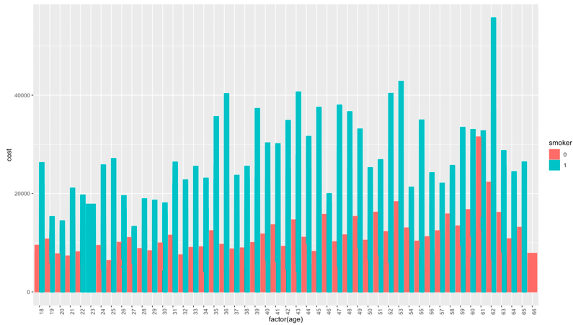
Expensive healthcare costs
Here we can see trend analysis of age vs cost of healthcare for individuals who smoke regularly that are paying greater than average healthcare cost.

Slide 13
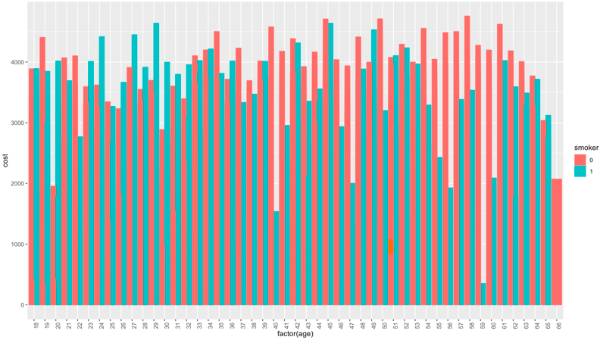
Non expensive healthcare costs
Here we can see trend analysis of age vs cost of healthcare for nonsmoker individuals paying less than average healthcare cost.

Slide 14
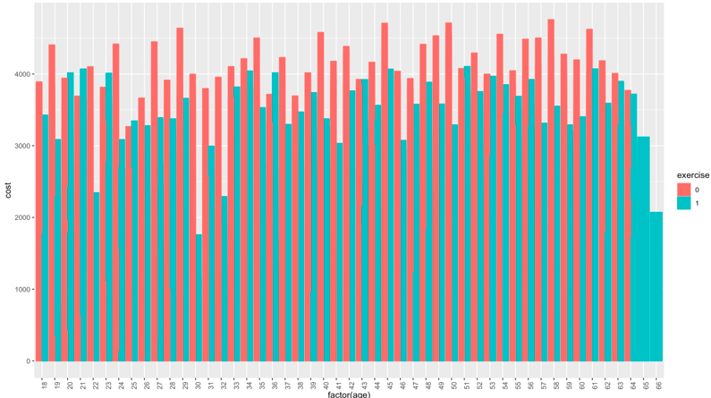
Non expensive healthcare costs
Here we can see trend analysis of age vs cost of healthcare for individuals who exercise regularly that are paying less than average healthcare cost.

Slide 15
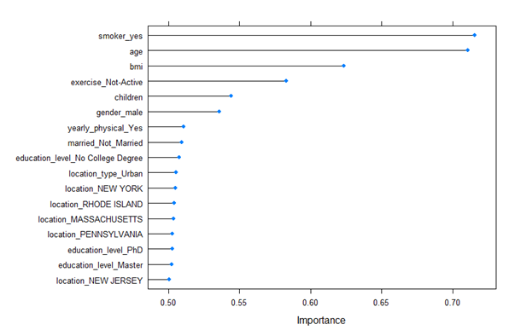
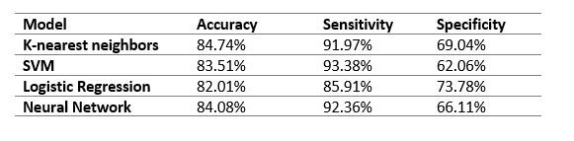
Analysis of all models

Slide 16
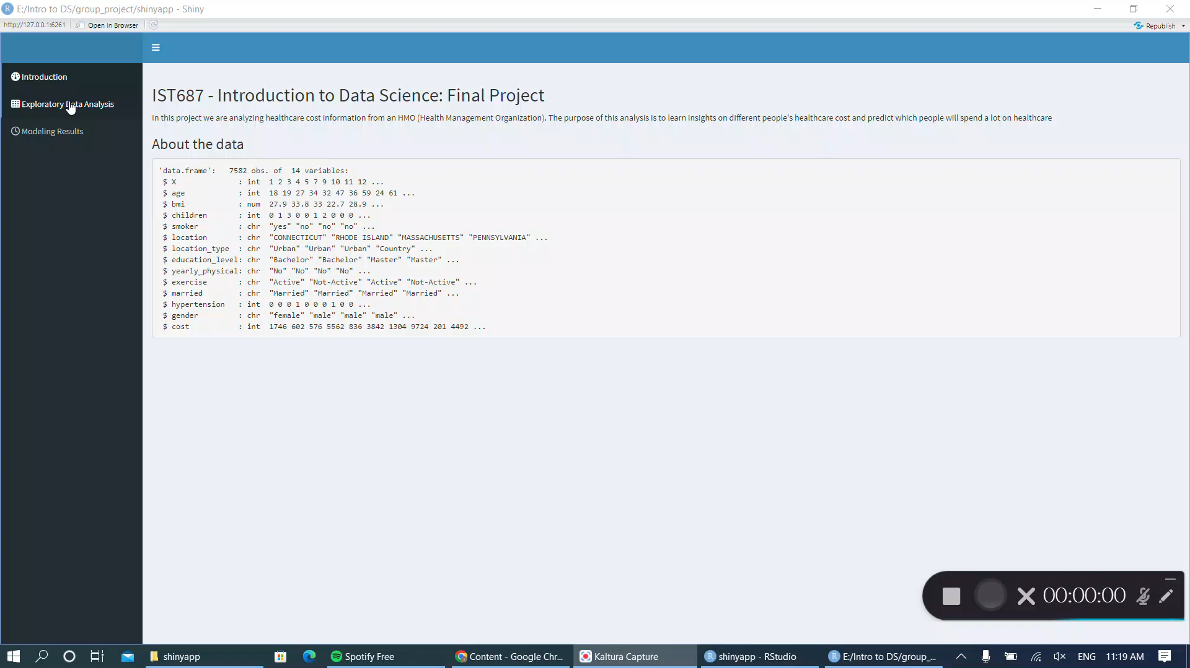
Shiny app

Slide 17
Recommendation & Conclusion
Discourage smoking among people by organizing campaigns and other events
Promote exercising by providing discounted prices to some facilities to people who are in risk groups
Encourage people to get yearly physical checkup by including it in their insurance plans or lowering the rates for limited time

Slide 18

Thank You

